Slide 1
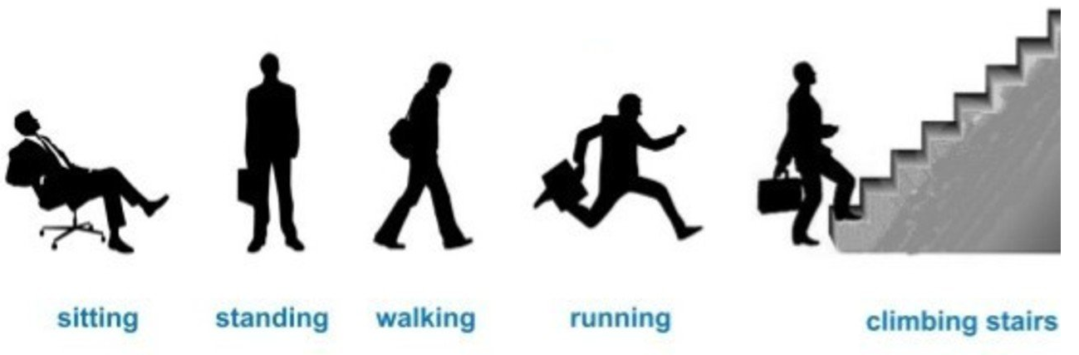
HUMAN ACTIVITY RECOGNITION

Slide 2
USES
CCTV surveillance (theft or violence detection)
Human computer interaction (through gesture recognition)
Health care (fall detection)

Slide 3
DESCRIPTION
This project is implemented in python. OpenCV was used for pre-processing of data and Keras library (with Tensorflow backend) for training the model.
Currently, it classifies eight different human activities - walking, running, jogging, galloping (sideways), leaping (jumping horizontally), one hand wave, two hand wave and bending.

Slide 4
FIRST CLASS OF ACTIVITIES
These eight activities fall into two classes. The first class includes those activities in which there is a motion of the entire body, thus the moving human silhouette can be easily extracted from the static background. This class includes- running, walking, leaping, galloping and jogging.

Slide 5
APPROACH (BINARY MOTION IMAGE)
Binary Motion Images – The representation of action video sequence by combining the image sequences into a single image in such a way that the recent frames are given more weightage as compared to the previous ones, is called Binary Motion Image.

Slide 6
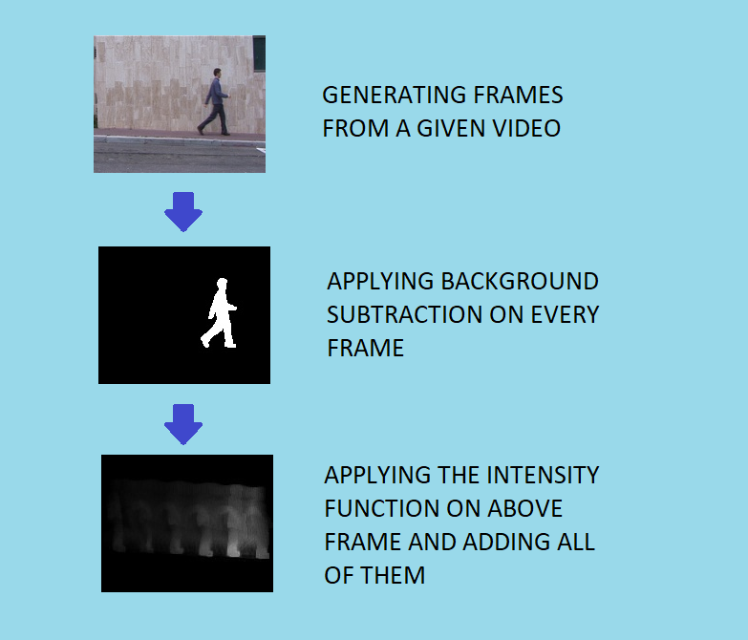
Generation of binary motion image

Slide 7
INTENSITY FUNCTION
j=0 TO TOTAL NO. OF FRAMES GENERATED
f(j)=jth EXTRACTED MASK
I(j)= INTENSITY OF jth FRAME
c=TOTAL DURATION OF VIDEO
t=TIME INTERVAL BETWEEN GENERATION OF 2 CONSECUTIVE FRAMES
For every j, c=c-t
I(j)∝ 1/c^3
BMI= ∑f( j ) I( j )

Slide 8
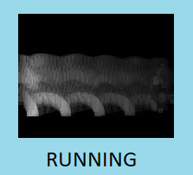
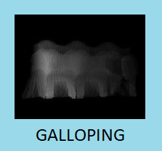
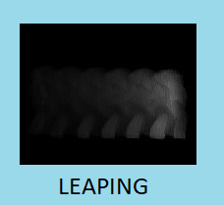
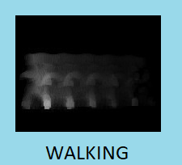
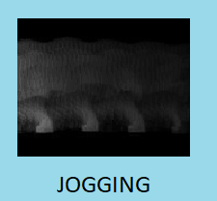
BINARY MOTION IMAGES

Slide 9
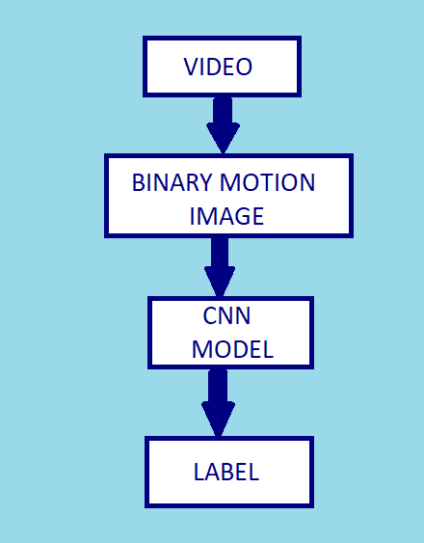
Training and testing
Convolutional Neural Network was used for the training part. The training accuracy was around 83%.
For testing the binary motion image was generated for given video sequence and it was fed to the cnn model. The video was then displayed with the predicted label.

Slide 10
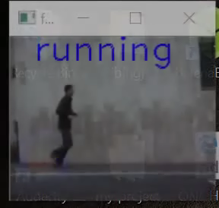
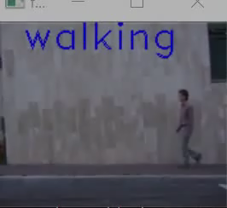
Demo videos

Slide 11
second CLASS OF ACTIVITIES
The second class includes those activities in which there is no motion of the entire body, thus the previous method can’t be used to extract the human silhouette. In this case the image of the actual background is needed so that arithmetic subtraction can be performed on every frame to get the human silhouette. This includes- one hand wave, two hand wave and bending.

Slide 12
Approach (binary image)
BINARY IMAGE - In this case, the binary image implies the image with the human silhouette represented in white and the background completely blackened. After subtracting the actual background from the generated frame, image thresholding was applied to get the binary image.

Slide 13
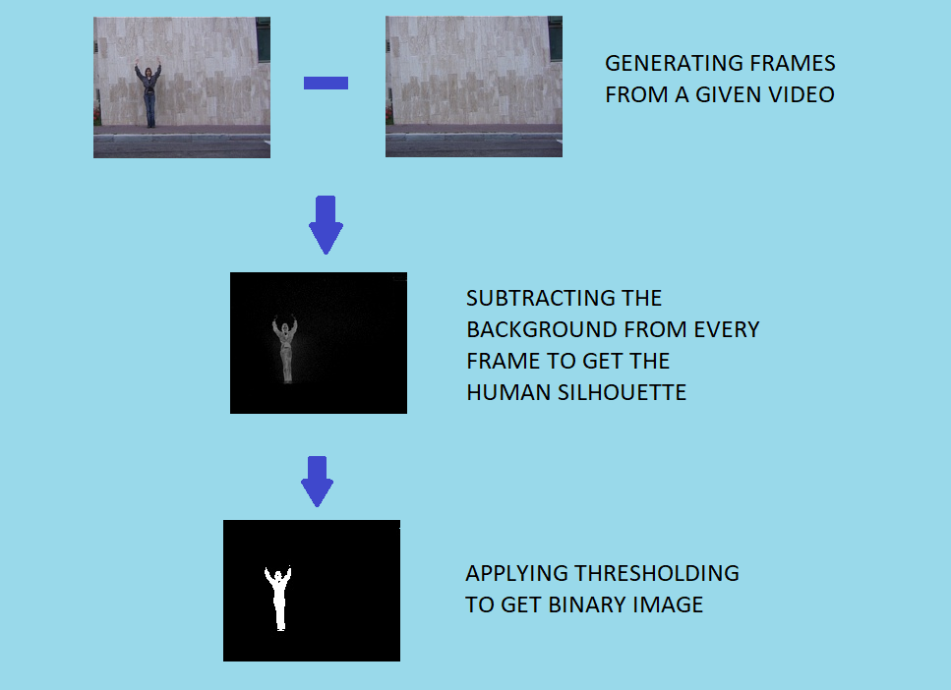
Generation of binary image

Slide 14
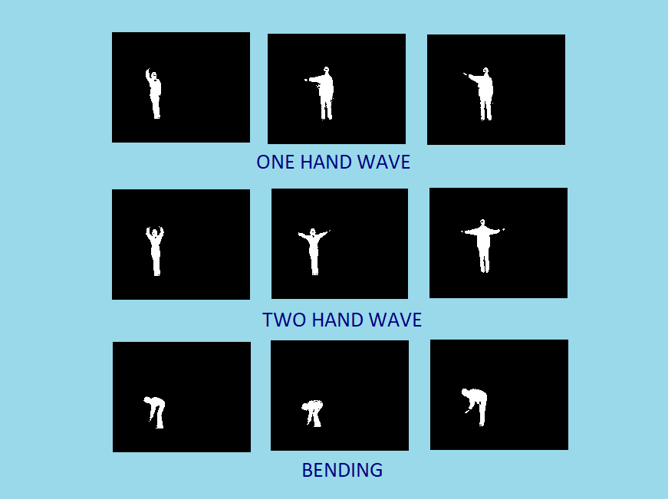
Binary IMAGES

Slide 15
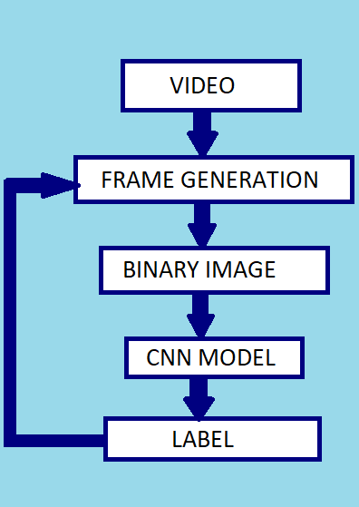
TRAINING AND TESTING
Convolutional Neural Network was used for the training part. The training accuracy was around 95%.
For testing a video, frames were generated and these frames were converted to binary images. This binary image was the fed to the cnn model and accordingly the label was predicted. All these frames were displayed along with the label.

Slide 16
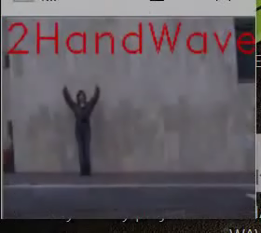
Demo video

Slide 17
THANK YOU !

